Slide 1

2024©
Connect 4 Game in Python
LASNIER - LAZREG – POILVE
Applied System Software

Slide 2
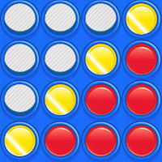
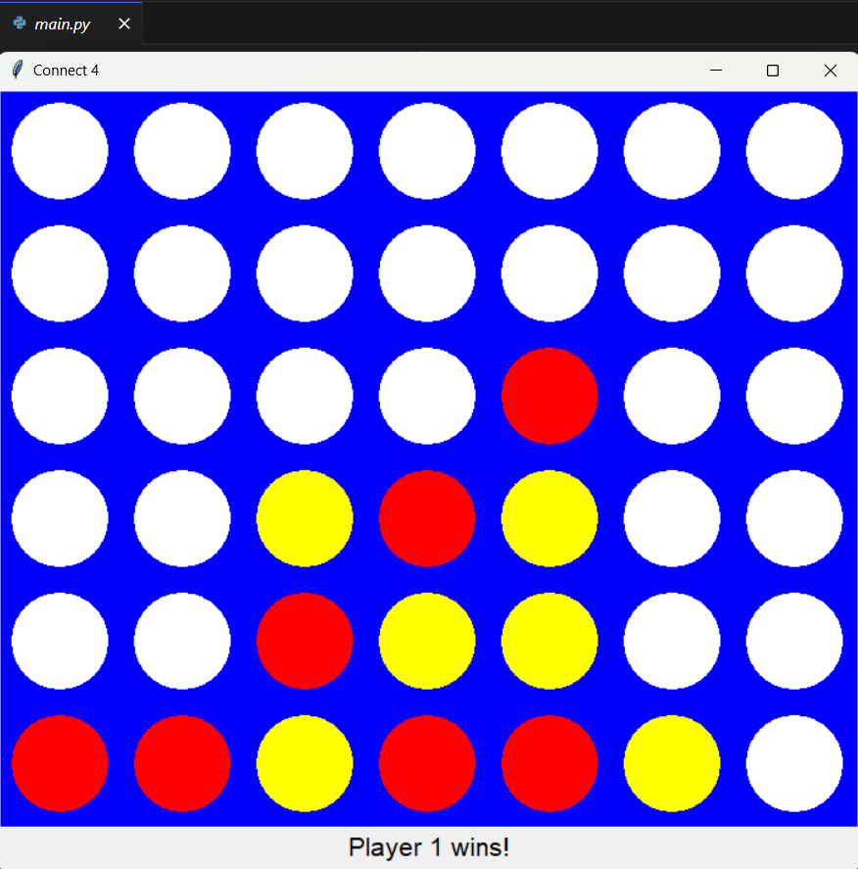
Project presentation
Goal: a Connect 4 video game coded in Python with a simple interface, with instructions on how to use the computer program.
Some Requirements:
Easy to use
2 players
2 discs color + blue grid
Fast with no bugs
Rules respected
Adaptable code

Slide 3
Agenda
1. Report 2.GitHub 3.Presentation
Software Requirements
Black-Box Testing/Test Cases
Design
Software Design
Implementation
Testing

Slide 4
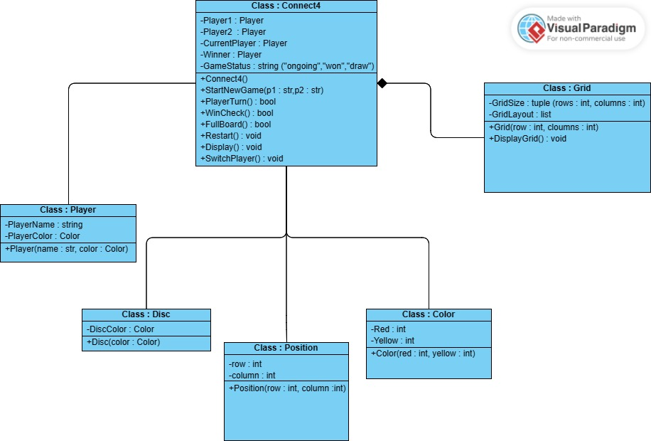
Software Design
UML class diagram :
Class :
Connect4
Player
Grid
Disc
Position
Color

Slide 5
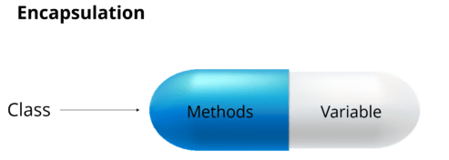


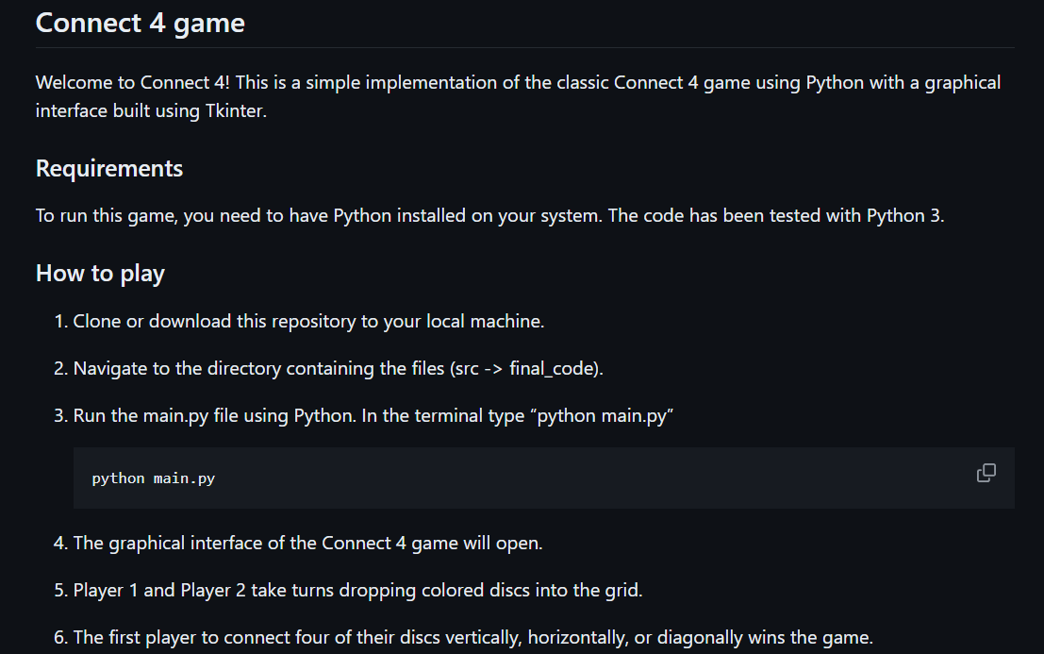
Implementation
Programming concepts used :
user input/output
Object Oriented Programming
Conditional statements
Composition (to represent relationship between our classes)
Event handling (to spawn a coin when the player clicks)
Encapsulation
+ Documentation (ReadMe)

Slide 6
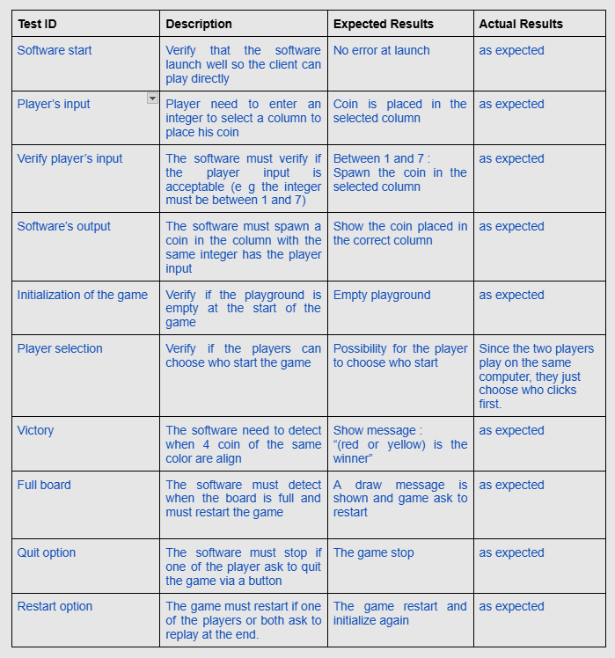
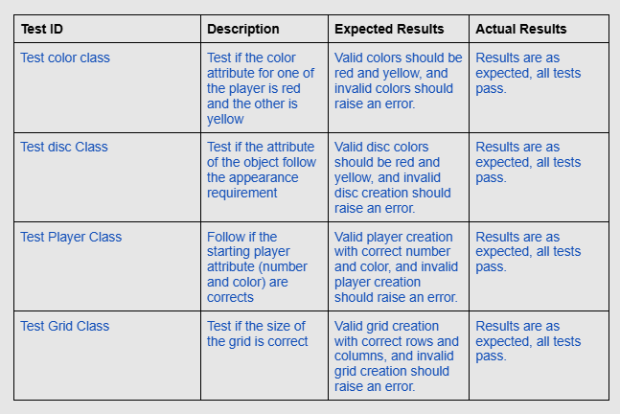
Black box testing

Slide 7
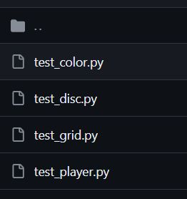

Tests of the game
4 files

Slide 8
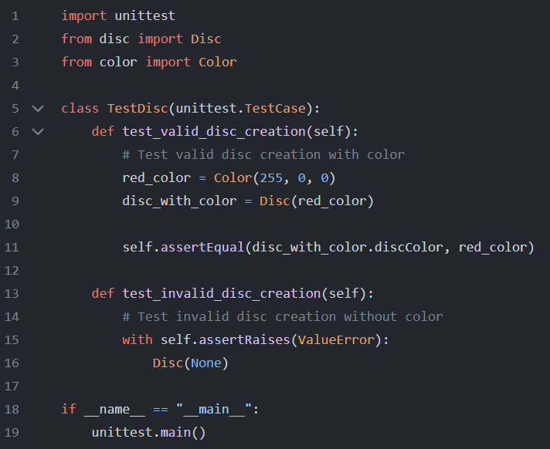
Screenshots :
Disc class test :

Slide 9
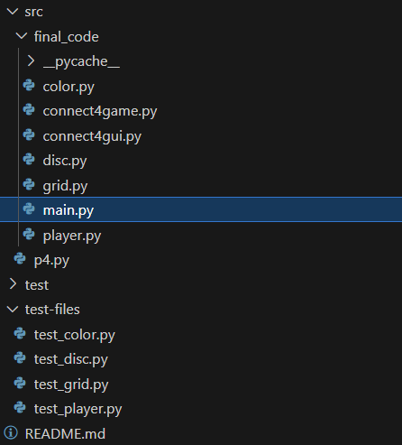
Demo of Alpha and Release version
Code Tree

Slide 10
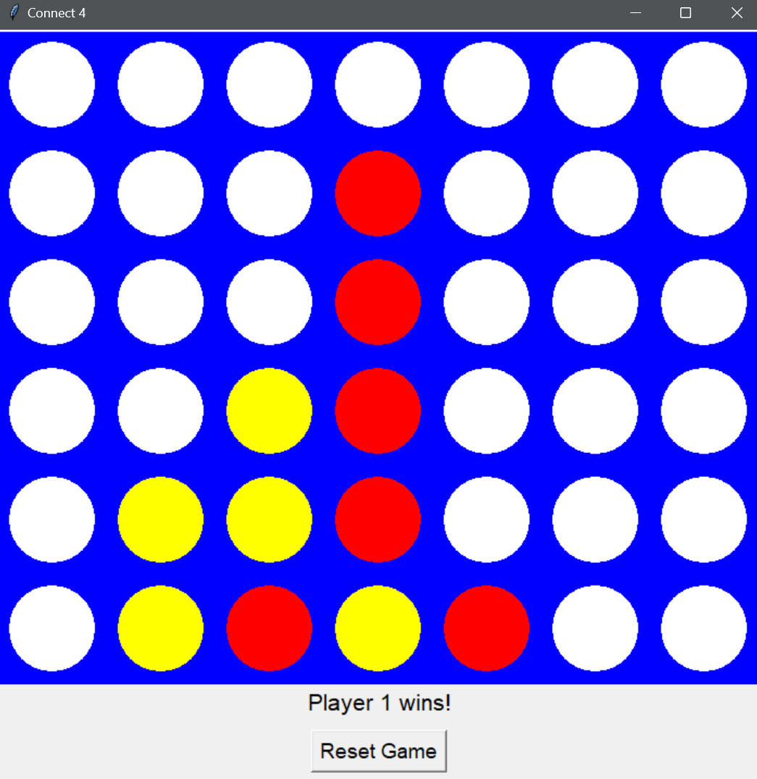
Screenshots :
Game window :

Slide 11
Repartition (7 à 10min)
Mehdi : Projet présentation (c'est bullshit je prends), agenda, testing, 2-3-7 et 9 ce sera un peu nous tous
Aurélien : Je m'occupe de design et implementation, je peux expliquer la slide avec le testing code de disc aussi.
Alexandre :

